Slide 1
Fracturing Using Supercritical CO₂ and Water – Application to Carbon Sequestration
Blessed Amoah
Integrated Core Characterization Center (IC³)
University of Oklahoma
CCUS Conference
October 4th, 2023
1

Slide 2
Outline
Motivation
Experimental procedure
Results and discussion
Breakdown pressure and acoustic emissions
Hypocenter location of acoustic emissions
Fracture dimensions
Permeability of fracture
Fracture morphology
Conclusions
Summary
Recommendation
2

Slide 3
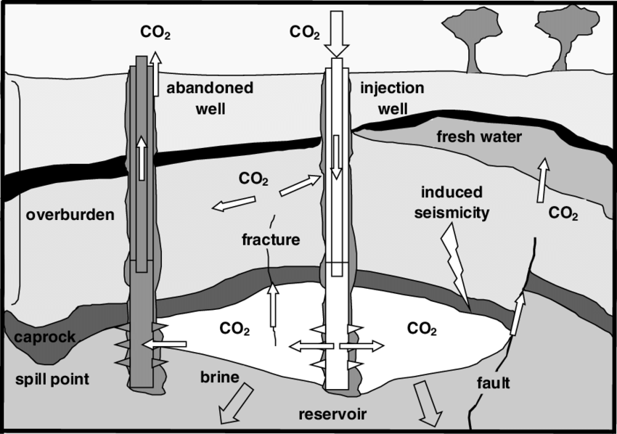
Motivation
High injection pressure of CO₂ :
Increase the storage capacity of CO₂
Injection – induced fractures pose risk to CO₂ containment
Breakdown pressure is typically determined in a leak-off test (uses a water-based fluid)
Damen et al. 2006
3
Notes:
Carbon Capture and Storage (CCS) is among the suite of technologies which can play an important role in meeting the climate goals.
95% of the estimated 280 MtCO2 to be stored in subsurface formations (IEA, 2022)
To safely sequester carbon dioxide in the subsurface CCS operators are required to inject CO2 below the formation breakdown pressure.
This precludes the creation of injection – induced fractures which poses the risk of CO2 leakage into freshwater aquifers and the atmosphere. With the creation of fractures, there is also an associated risk of induced seismicity which can be hazardous to the environment.
However, higher injection pressure allows to displace more formation brine, thus enhancing the effective storage capacity of the sequestration zone.
To optimize the injection pressure, mini-frac tests are typically conducted a drilling fluid that is water based and not gas-based to determine the formation breakdown pressure.
However, considering the significant dissimilarity in fluid properties between water – based fluid and supercritical CO₂ (ScCO₂) the breakdown pressure, failure mechanism and extent of damage resulting from the injection of these different fluids can vary.

Slide 4
Objective
Investigate induced fractures risk during supercritical CO₂ injection
4

Slide 5
Experimental procedure
4 in
Sample | Gas filled porosity (%) | Permeability (md) | Mineralogy (wt%)
 |  |  | Quartz | Clay | Others
Tennessee sandstone (six cylindrical samples) | 6.5 | 0.015 | 84 | 11 | 5
5.2 in
Fluid injection at 10 cc/min
Pre fracturing characterization:
Permeability
Porosity
Mineralogy
Post fracturing characterization:
Breakdown pressure
Acoustic emissions
Fracture dimensions
Permeability
Fracture morphology
Saturation
(2.5% KCl brine, 5000 psi) 72 hours
Measure P-wave velocity with azimuth
Rock fracturing
(Water or scCO₂)
Monitor acoustic emissions (16 sensors)
Stresses (psi): σ_{V}= 1500, σ_{h} = 500, σ_{H}= 3000
5

Slide 6
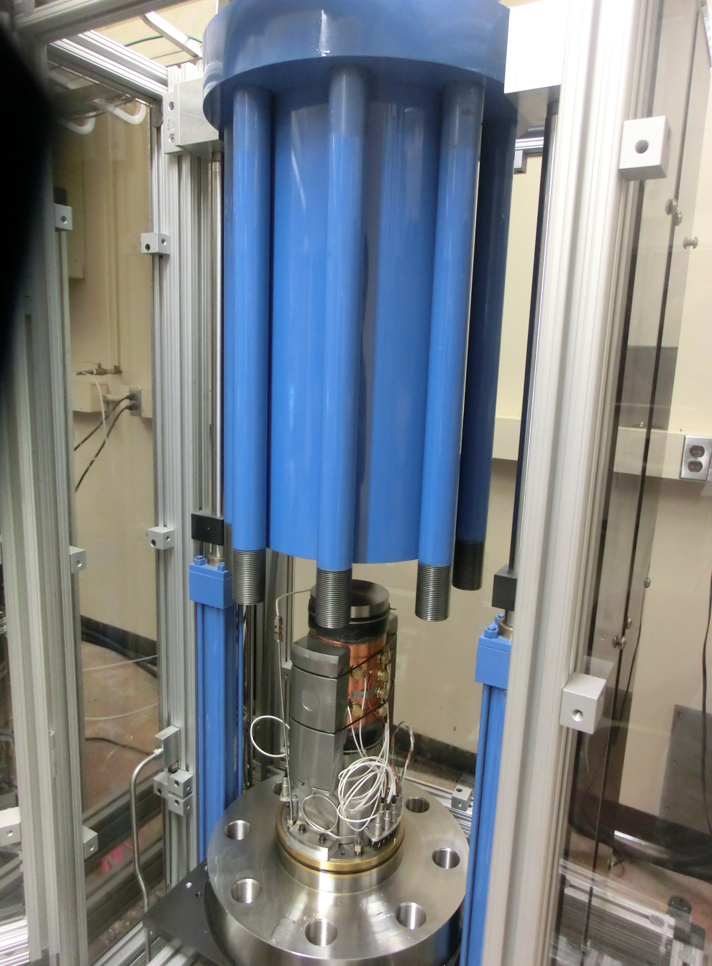
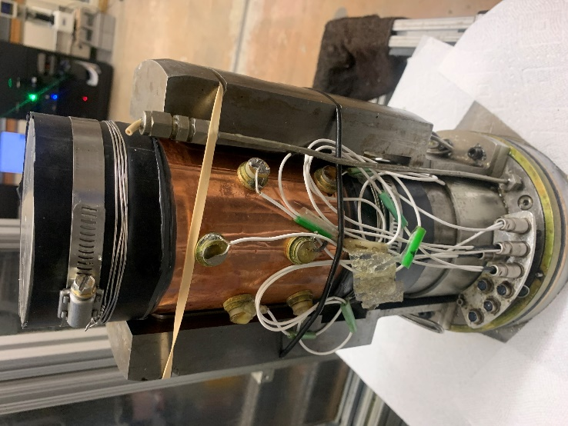
Experimental procedure
4”
Top of sample
Injection point
Axial Loading System
Unjacketed sample
5.3”
Epoxy around the tubing
Borehole
Confining vessel
Steel tubing
Bottom of sample
Jacket
Jacketed sample
Flat jacks
Jacketed sample
Acoustic
transducer
Triaxial Cell
6
Notes:
I have two tests on core samples from the same block of Tennessee sandstone. One was with ScCO2 and the other with water
In terms of mineralogy, the samples are predominantly quartz rich with porosity of about 6.5%. The cores were saturated after which velocity measurement was taken on them. Afterwards I jacketed the samples and fixed 16 transducers on them. Only channel 14 is not working.
This is the profile of pressure and cumulative events generated during the water injection. There is a fast build up of pressure due to the incompressible nature of water until the sample failed which was accompanied with a sharp drop of pressure. Then the pressure stabilized at the minimum horizontal stress. More events at post propagation due to crushing of asperities on the fracture surfaces
Here is the profile for the ScCO2 injection. It appears different from that of water. There is a slow built up of pressure due to the compressible nature of ScCO2 until sample failure. Compared to the water injection profile, there is a slow drop in pressure after failure. We see more events at the propagation phase, and I attribute this to the expansion of ScCO2.

Slide 7
Results and discussion
7

Slide 8
Breakdown pressure and acoustic emissions
Water injection
scCO₂ injection
8

Slide 9
Breakdown pressure and acoustic emissions
380 psi (16%)
scCO₂
scCO₂
Acoustic emissions increased by a factor 4 using ScCO₂.
9
Notes:
The average breakdown pressure with ScCO₂ is about 380 psi (16%) lower than with water.

Slide 10
Hypocenter location: plan view
Water injection
scCO₂ injection
$$σ_{H}$$
$$σ_{H}$$
$$σ_{H}$$
$$σ_{H}$$
Located event Sensor
10
Notes:
The wider distribution of events about the x axis for the ScCO₂ fracturing experiment is due to:
Intense microcracking
Complexity of the velocity model

Slide 11
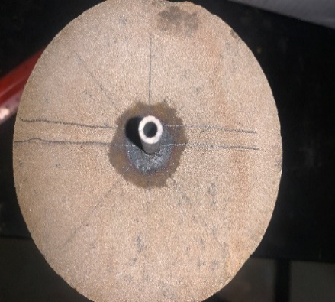
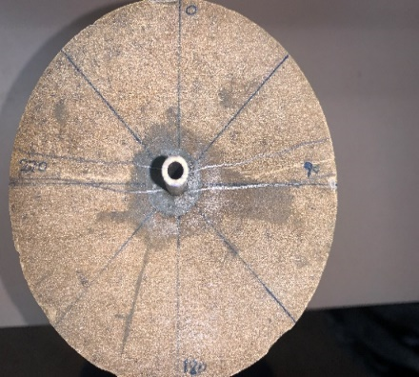
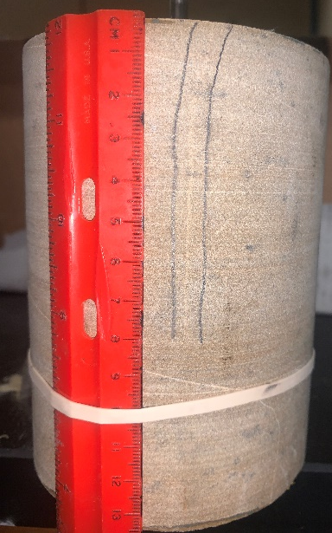
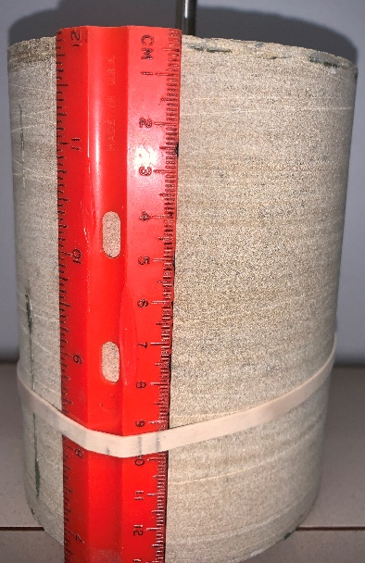
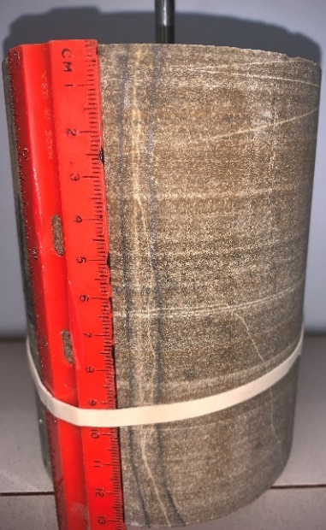
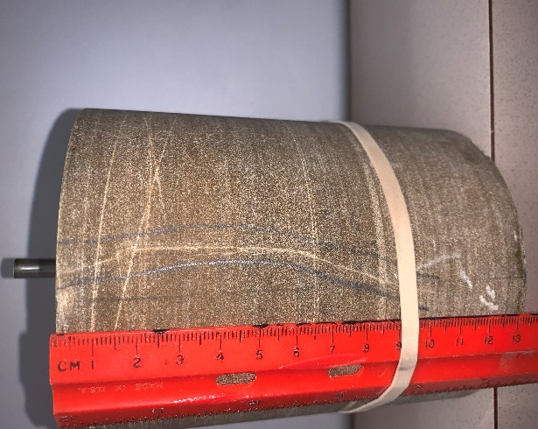
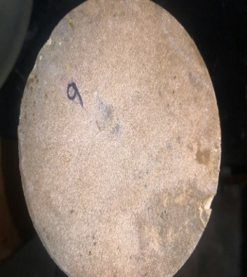
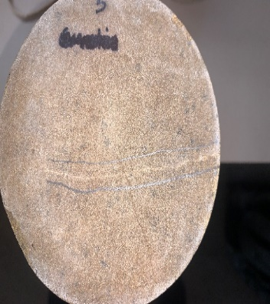
Fracture dimensions
Water injection
scCO₂ injection
Bottom
Bottom
σ_{H}
σ_{h}
Left side view
Right side view
Left side view
Right side view
σ_{V}
σ_{V}
σ_{h}
Fracture
σ_{h}
Fracture
σ_{H}
σ_{H}
Fracture
No fracture
Fracture
Top
Top
Fracture
No fracture
Fracture
11

Slide 12
Gas permeability of fractured plugs
Helium gas
Dried state
1”
Fracture
2”
Y
X
Bore hole
Plug
Fracture
1”
0.2” gap
12

Slide 13
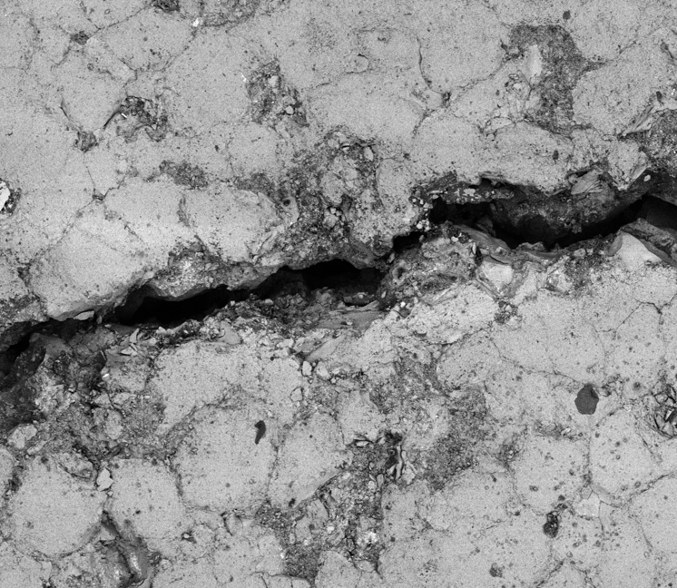
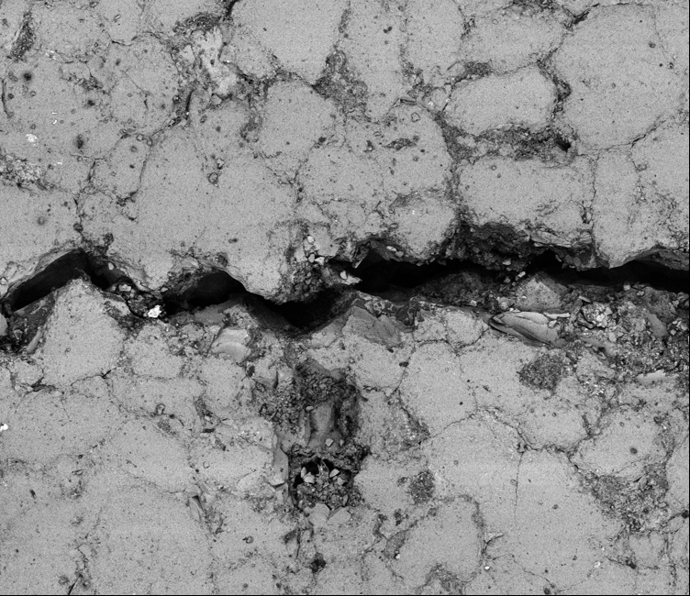
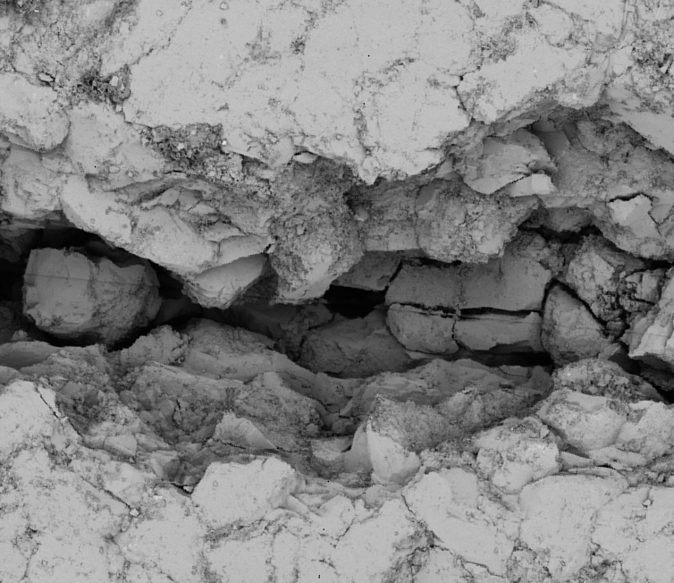
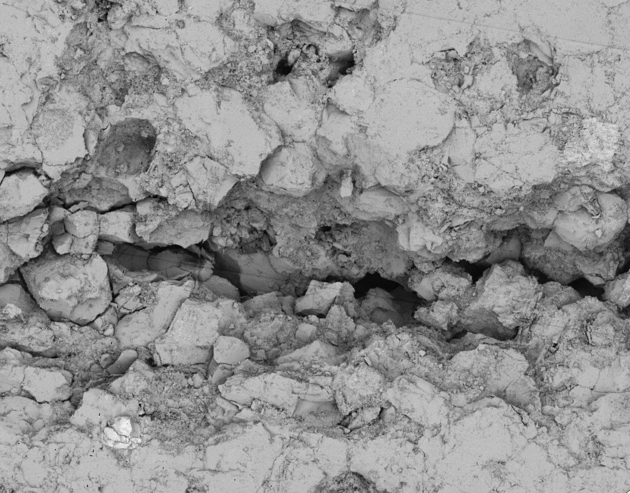
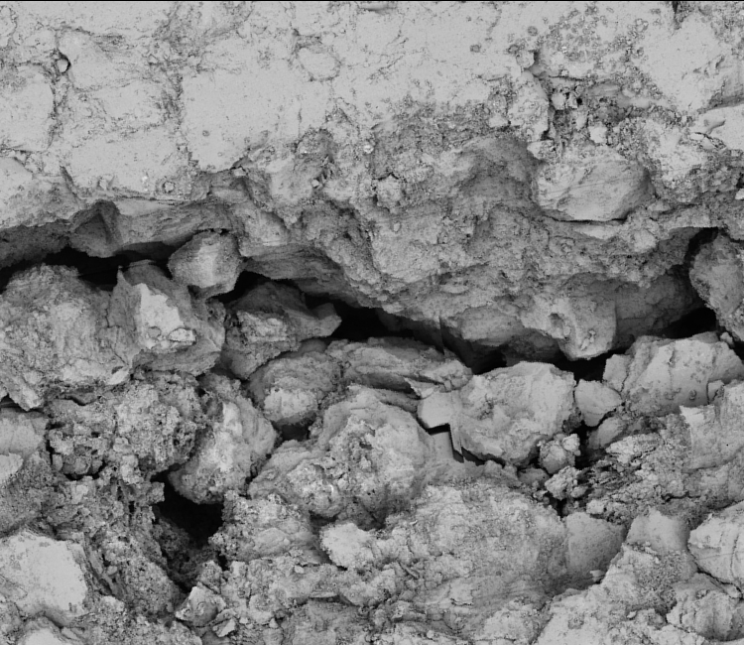
Fracture morphology
σ_{H}
X
Clean fracture (without loose grain)
Z
SEM study
Secondary fracture
Primary fracture
Injection point
Water injection
40 µm
Disk for imaging
0.2” in gap
1“
Fracture aperture
Asperities
Aligned asperities
400µm
400µm
400µm
σ_{H}
Wider fracture aperture
Secondary cracks
Intense microcracking
scCO₂ injection
200 µm
Mismatched asperities
Courtesy: Mark Curtis
Multiple loose grains
Courtesy: Mark Curtis
400µm
400µm
400µm
13

Slide 14
Conclusions
Our experiments with ScCO₂ and water in Tennessee sandstone shows:
The average breakdown pressure with ScCO₂ is about 380 psi (16%) lower than with water.
ScCO₂ fracturing shows an increase by a factor of 4 in acoustic emissions
Fractures created by ScCO₂ are more complex (longer length, wider aperture, mismatched asperities and loose grains). Consequently, this leads to an increase in permeability of fractures by one order of magnitude.
Summary
Formation breakdown will occur at a lower pressure with ScCO₂ injection than the estimated breakdown pressure from leak-off test. Generated fractures can propagate long distances into the formation and can be more transmissive. Thus, these fractures can easily facilitate the migration of CO₂ from the sequestration zone.
Recommendation
Laboratory fracturing studies with CO₂ on core samples to determine the exact breakdown pressure.
Thank you
14

Slide 15
Acknowledgement
Advisors
Dr. Chandra Rai
Dr. Carl Sondergeld
Dr. Son Dang
Dr. Mark Curtis
Dr. Deepak Devegowda
IC³ Technical Assistants
Micaela Langevin
Gary Stowe
15

Slide 16
References
Damen, K., Faaij, A.P.C., and Turkenburg, W.C. 2006. Health, Safety and Environmental Risks of Underground Co2 Storage-Overview of Mechanisms and Current Knowledge. Climatic Change.
16

Slide 17
Back-up slides
17
Notes:
Diffusion coefficient of

Slide 18
Breakdown pressure and acoustic emissions
380 psi (16%)
ScCO₂
ScCO₂
Acoustic emissions increased by a factor 4 using ScCO₂.
$$P_{b}^{H}=3σ_{V}−σ_{H}−P_{p}+T_{o}, if σ_{V<}σ_{H}$$
ScCO₂ viscosity: 15 times lower than water viscosity (Deng. et al. 2021)
18
Notes:
The average breakdown pressure with ScCO₂ is about 380 psi (16%) lower than with water.

Slide 19
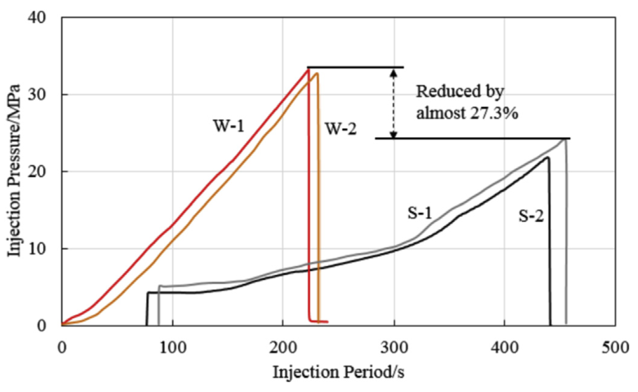
Lv et al. 2019)
Notes:
I have two tests on core samples from the same block of Tennessee sandstone. One was with ScCO2 and the other with water
In terms of mineralogy, the samples are predominantly quartz rich with porosity of about 6.5%. The cores were saturated after which velocity measurement was taken on them. Afterwards I jacketed the samples and fixed 16 transducers on them. Only channel 14 is not working.
This is the profile of pressure and cumulative events generated during the water injection. There is a fast build up of pressure due to the incompressible nature of water until the sample failed which was accompanied with a sharp drop of pressure. Then the pressure stabilized at the minimum horizontal stress. More events at post propagation due to crushing of asperities on the fracture surfaces
Here is the profile for the ScCO2 injection. It appears different from that of water. There is a slow built up of pressure due to the compressible nature of ScCO2 until sample failure. Compared to the water injection profile, there is a slow drop in pressure after failure. We see more events at the propagation phase, and I attribute this to the expansion of ScCO2.

Slide 20
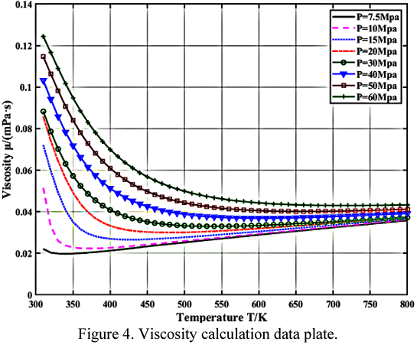
Viscosity and diffusion coefficient of ScCO₂
Viscosity: 0.05 – 0.07 cp @ 310K and 11.8 MPa
Viscosity: 20 – 15 times lower than that of water
Diffusion/leak off rate of CO2 @ 333.15 – 373.15 K, 10-25 MPa, 50 mD = 0.9 – 18.5 * 10⁻⁴ cm³/s (Lv et al., 2019)
Injection/pressure build up rate: 10 cm³/s
Compressibility of CO₂ = 10⁻⁹ – 10⁻⁸ Pa⁻¹ which is 1 – 2 order of magnitude greater than that of water
Deng et al., 2021
Notes:
Diffusion coefficient of

