Slide 1


Organic Oil Recovery
TITLE GOES HERE
An EOR technology trial in the Scott oil field
Subtitle here
Scott Field Joint Venture and Hunting Energy Services
DEVEX May 2023
Date goes here

Slide 2
Forward Looking Statement
“This presentation includes "forward-looking statements" within the meaning of the United States Private Securities Litigation Reform Act of 1995, including statements regarding expected future events, business prospectus or financial results. The words "expect", "anticipate", "continue", "estimate", "objective", "ongoing", "may", "will", "project", "should", "believe", "plans", "intends" and similar expressions are intended to identify such forward-looking statements. These statements are based on assumptions and analyses made by CNOOC Limited and/or its subsidiaries (the “Company”) in light of its experience and its perception of historical trends, current conditions and expected future developments, as well as other factors the Company believes are appropriate under the circumstances. However, whether actual results and developments will meet the expectations and predictions of the Company depends on a number of risks and uncertainties which could cause the actual results, performance and financial condition to differ materially from the Company's expectations, including but not limited to those associated with fluctuations in crude oil and natural gas prices, the exploration or development activities, the capital expenditure requirements, the business strategy, whether the transactions entered into by the Company can complete on schedule pursuant to their terms and timetable or at all, the highly competitive nature of the oil and natural gas industries, the foreign operations, environmental liabilities and compliance requirements, and economic and political conditions in the People's Republic of China. For a description of these and other risks and uncertainties, please see the documents the Company files from time to time with the United States Securities and Exchange Commission, including the Annual Report on Form 20-F filed in April of the latest fiscal year. Consequently, all of the forward-looking statements made in this presentation are qualified by these cautionary statements. The Company cannot assure that the results or developments anticipated will be realised or, even if substantially realised, that they will have the expected effect on the Company, its business or operations.”

Slide 3
Contents
Organic Oil Recovery Technology Overview
Trial Roadmap
J17 Production Well Pilot
J40 – J41z Producer – Injector Pilot
Lessons Learned
Conclusions

Slide 4

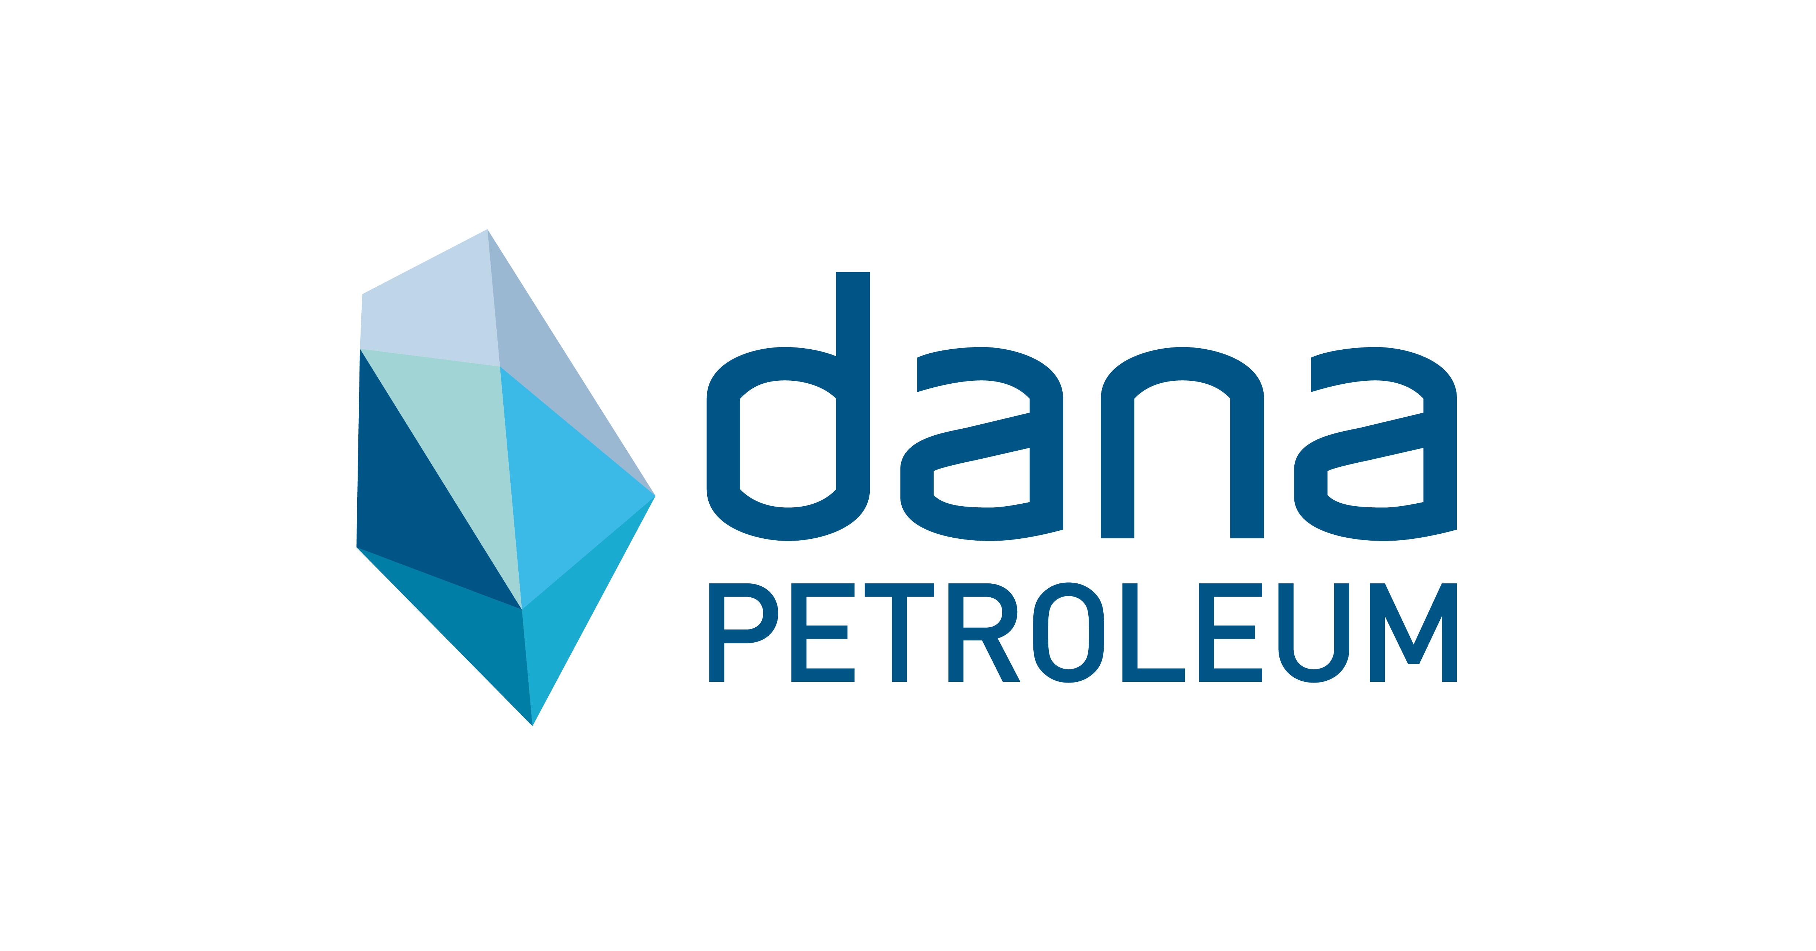

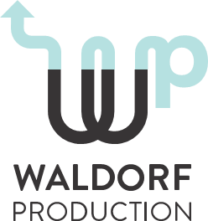


Acknowledgements

Slide 5
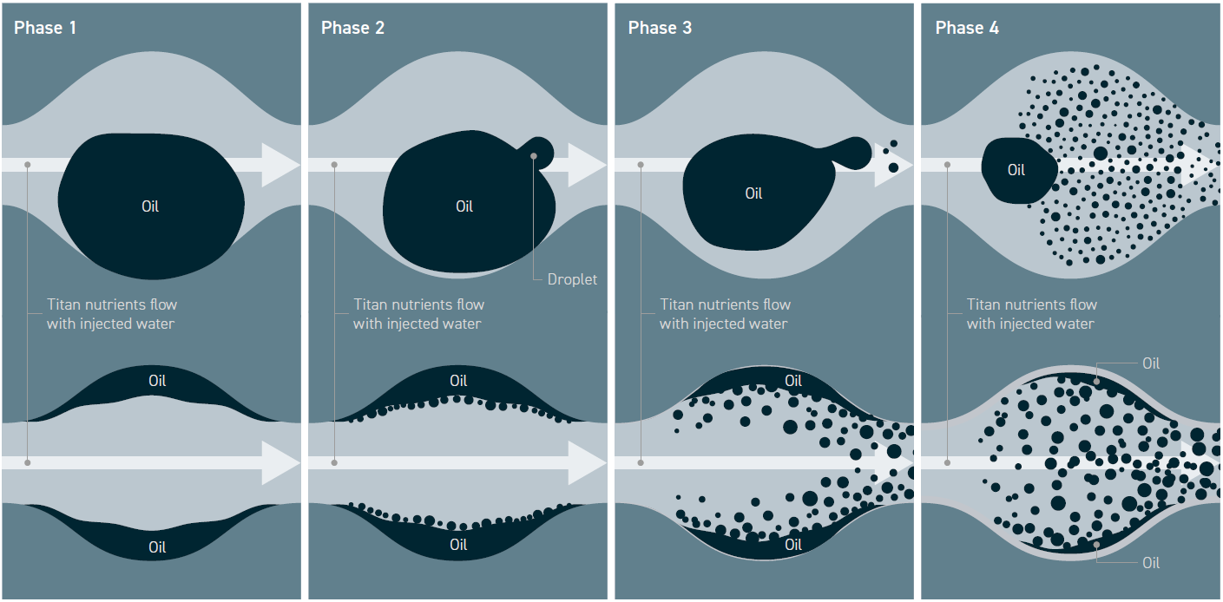
Organic Oil Recovery, Technology Overview
Organic Oil Recovery (OOR) is a tertiary recovery mechanism that increases oil production by mobilizing microbes that pre-exist in oil reservoirs. By batch treating with supplemental nutrients, the process significantly increases a specific microbial population. As part of their life cycle, these microbes develop a hydrophobic skin, move to the oil / water interface, and in so doing reduce the surface tension resulting in the release of trapped and residual oil.

Slide 6
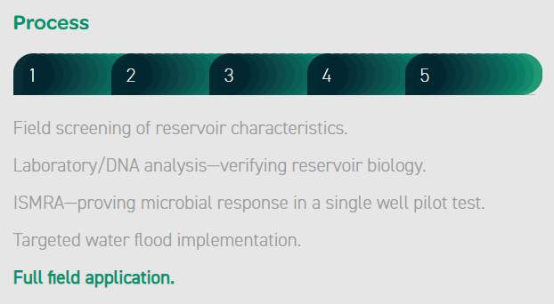
Scott Field Organic Oil recovery technology trial
The Organic oil recovery technology trial in the Scott oil field began in 2018 with desktop screening and subsequent collection of produced water samples from wells J17 and J23z.
In July 2020 a production well treatment (ISMRA) was performed in J17, which demonstrated that OOR successfully stimulated the resident microbes and created additional oil production.
During 2022 and 2023 a 12 month injector producer trial is being performed, which if commercially successful may result in a wider scale roll out of OOR within the Scott field.
Time
2018 2019 2020 2021 2022 2023 2024+
Screening
Sampling and Analysis
J17 Production pilot
J40 Production pilot
J41z – J40
Inj – Prod trial
Full-Field roll out
Phase
#1 #2 #3 #3 #4 #5

Slide 7
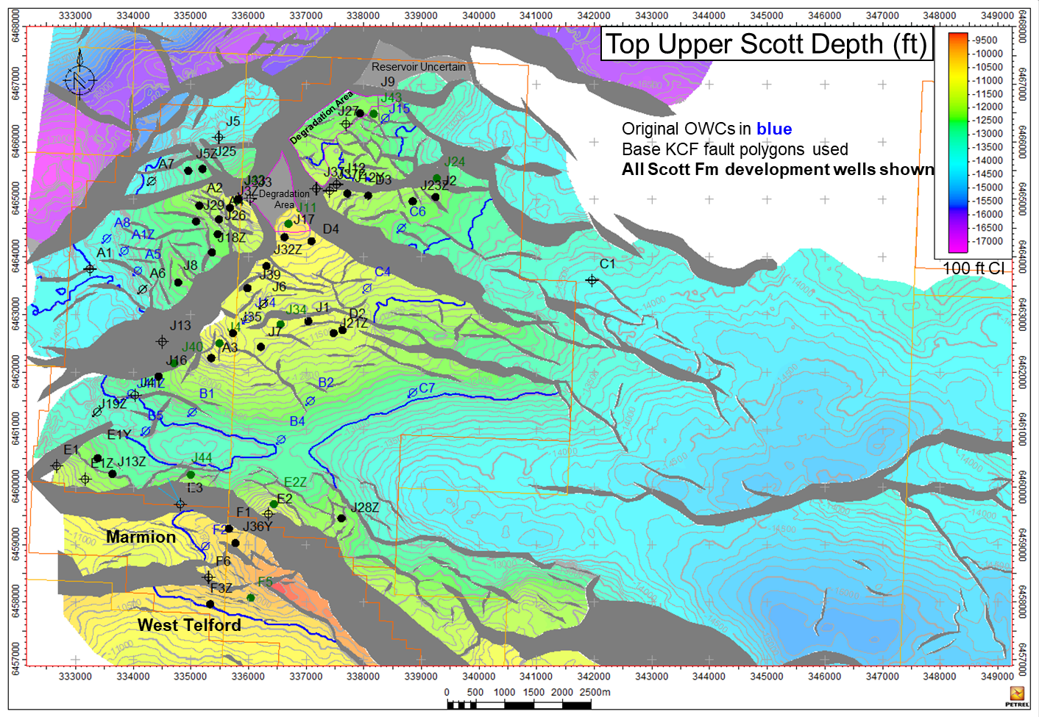
Scott Field Map showing relevant well locations
J23z
J17
J40
J41z

Slide 8
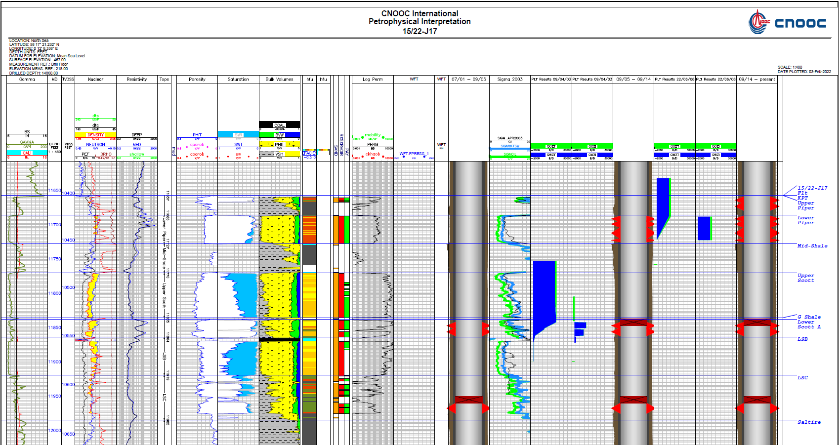
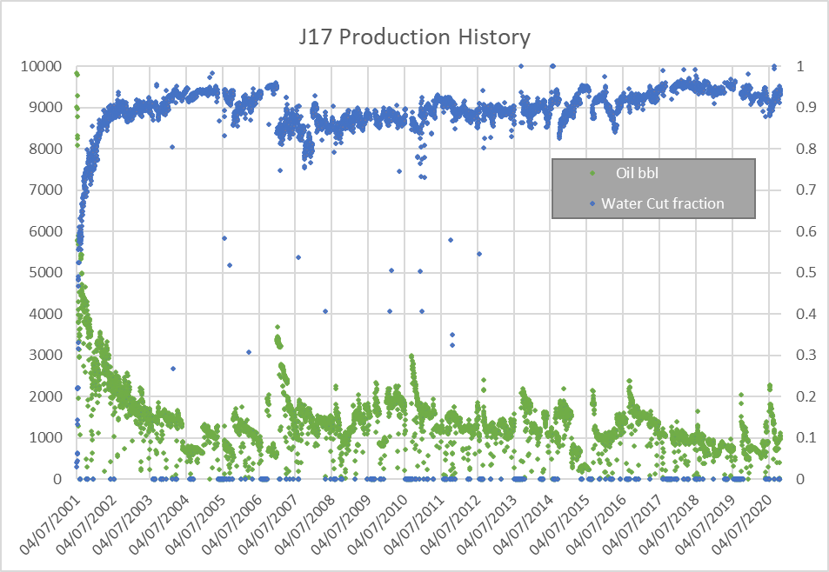
ISMRA: J17 production well pilot selection criteria
Selection considerations
At the time (2020) of selecting a well for the ISMRA the Scott field was hotter than any previous application of OOR, and close to the upper temperature threshold.
To mitigate some of the effects of temperature a shallow well (J17) was selected.
Since 2014 J17 has produced only from the Piper reservoir, therefore when bull heading the nutrient the destination is not uncertain.
Piper Only Production
Selection considerations
Production performance of J17 is typical for a mature Scott oil producer.
Water Cut has been greater than 90% for more than 10 years.
J17 is a productive well with liquid rates of 10 – 20,000 bpd.
Although J17 is shallow, it has behaved similarly in character to all the other Scott production wells.

Slide 9
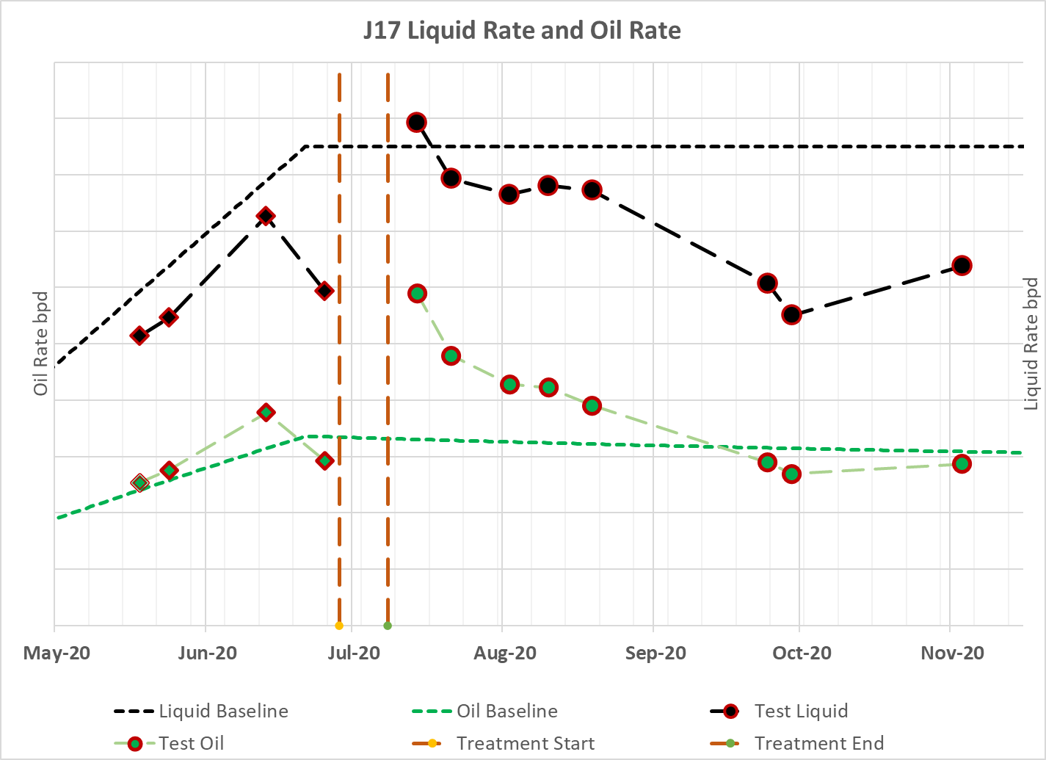
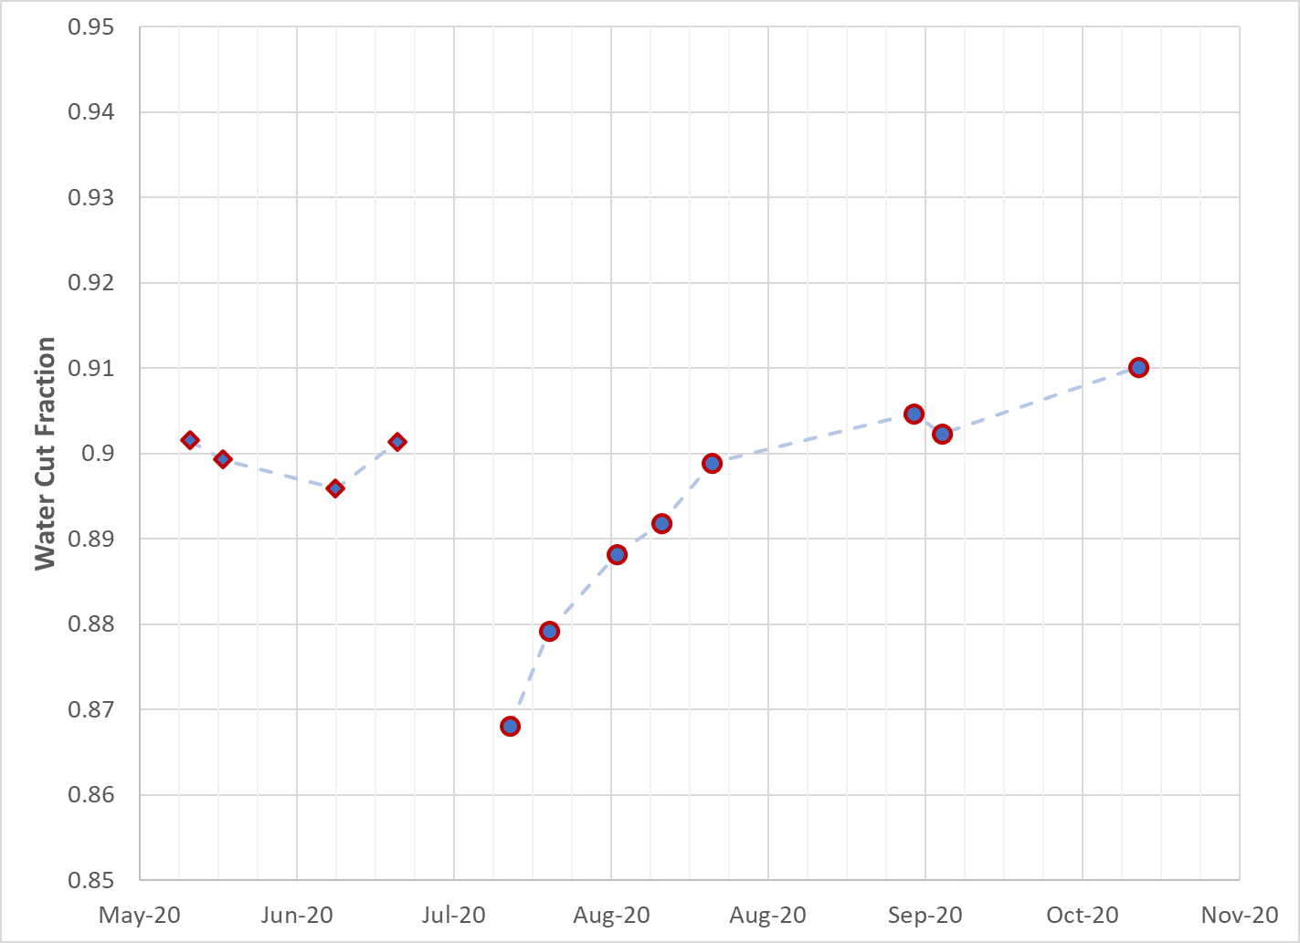
J17 production well pilot results
> 20,000 bbls of production above the baseline; ~ 4% reduction in water cut
OOR nutrient deployment
Pre-deployment well test
OOR nutrient deployment
Post-deployment well test
Injection online → increasing and high liquid rate
Injection offline → decreasing liquids
4% Water cut decrease
100% oil rate increase
CAUTION: Much debate took place within the Scott partnership as to how much of the production benefit should be attributed to OOR versus water injection and/or flush production.

Slide 10
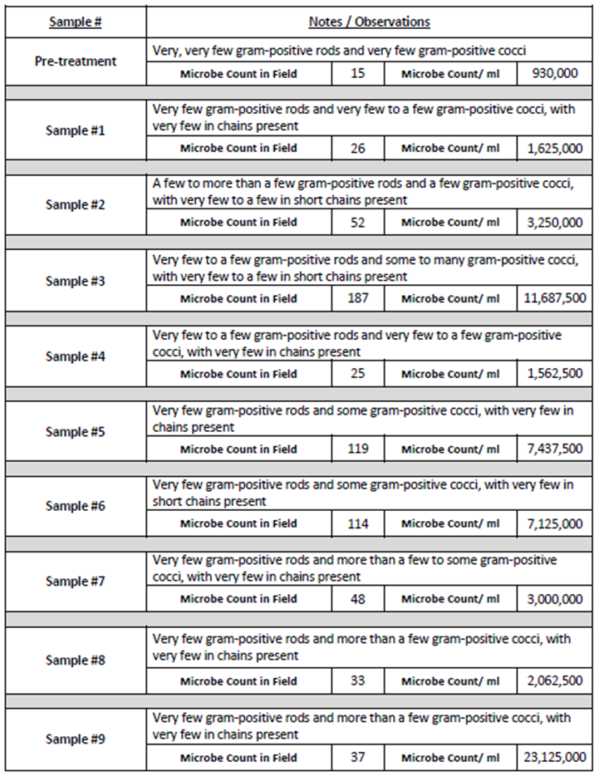
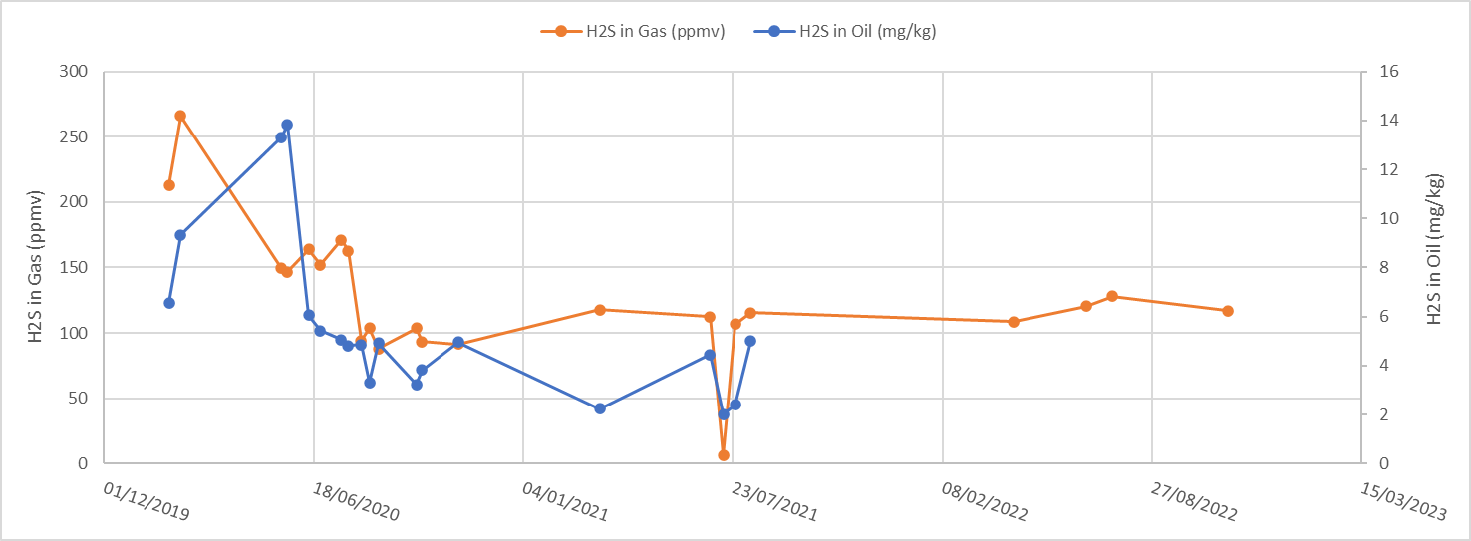
J17 production well pilot results
H₂S reduced by 30%; Microbes increased ~ 5 fold
Elevated microbe numbers were evident in all post treatment samples.
The maximum increase was 10 fold, while the average increase was 5 fold. The microbe numbers tended to fluctuate, which is thought to be typical of a growth-death-growth cycle.
As a by-product of the OOR treatment H₂S in the gas phase reduced by 30% and has remained at this lower level for 2 years.

Slide 11
Scott Field Map showing relevant well locations
J23z
J17
J40
J41z

Slide 12
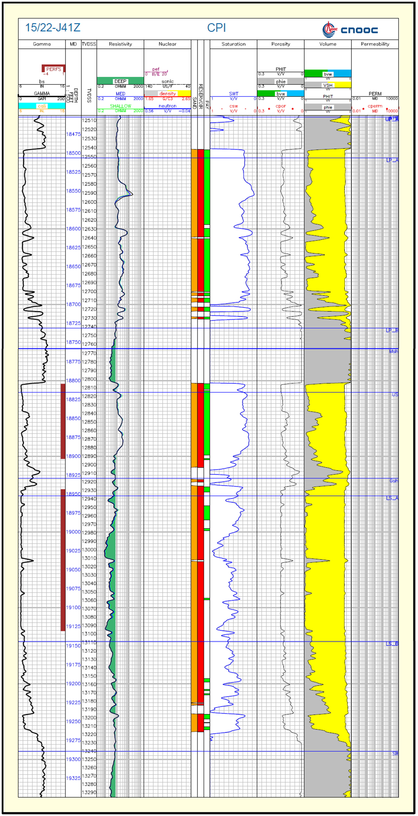
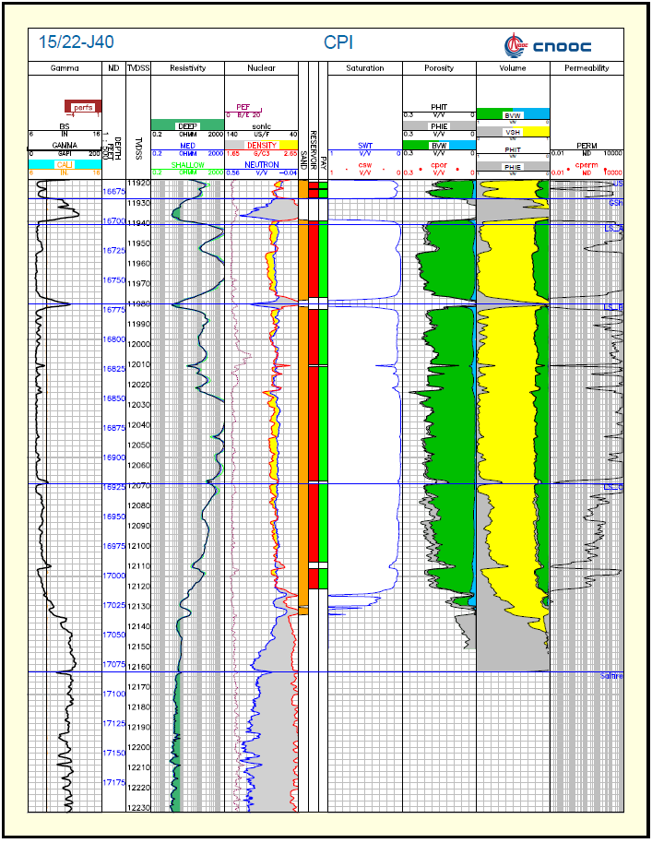
Injector - Producer Trial, Selection Criteria (J41z – J40)
Block I West is understood to be mostly isolated from Block I main.
  The fluid properties in Block IW are different from Block I main.
  J40 did not get pressure support until J41z was drilled
There is proven communication between J41z and J40.
  The pressure wave is felt at J40 within 30 minutes of starting injection in J41z.
  Tracer injected at J41z is detected at J40 within a few months.
There are currently no other producers or injectors in Block IW that can interfere with the results of the OOR trial.
Lower Scott – high quality continuous Lower Scott reservoir from J41z to J40. Water injection support is proven and rapid.
OWC 13007 fttvdss

Slide 13
Injector (J41z) – Producer (J40) OOR Trial Timeline
Mar 2022
Sept 2022
Dec 2022
2023+
J40 Production well Pilot – Identical to J17 trial (2020) (123ºC vs 105ºC)
Place order for J41z (injector) nutrients. (3 batches to span 12 month period)
J41z injector well batch treatments
J41z injector well batch treatments
J40 Pilot is successful. Good early indications of incremental oil.
Perform J41z 1st batch treatment in Dec 2022. Continue monitoring and data collection.
Perform J41z 2nd and 3rd batch treatments (Mar 23 & June 23). Consider extending the trial into years 2 and 3. Or extend roll out to more wells.
To determine whether the hotter conditions in Block IW remain suitable for OOR (Mar 22)
J40 Pilot is not successful. No production uplift.
Do not proceed with J41z batch treatments.

Slide 14
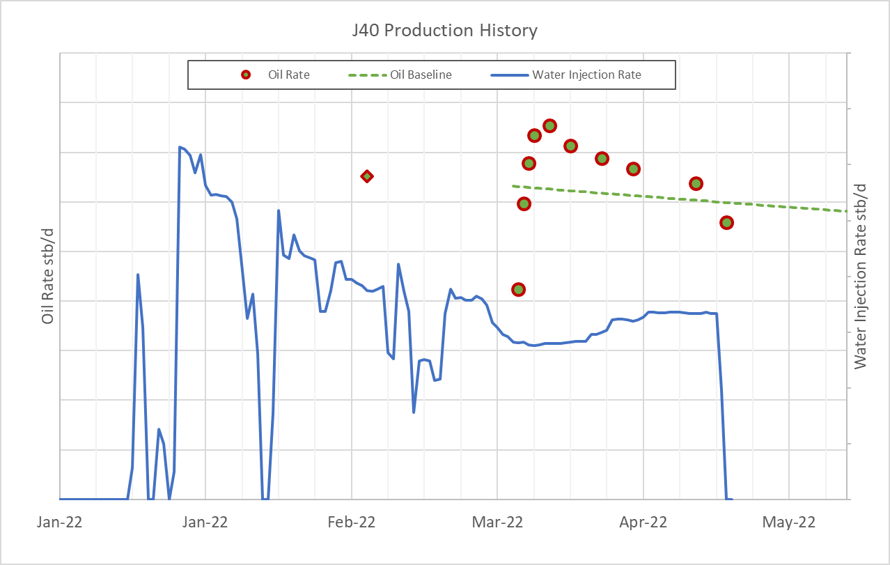
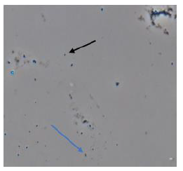
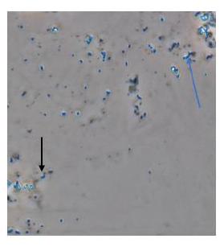
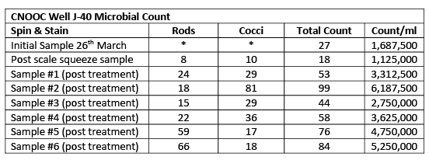
J40 Production well pilot results
18% above baseline; Production uplift for 1 month; Microbes increased x3 fold
OOR deployment
Stable water injection
Microscope imaging pre OOR treatment and post SISQZ. Control to see what and how many microbes were present
Image from sample#2 taken 6h after the well was restarted post OOR treatment. It shows an increase in microbes (Rods blue arrow and Cocci blue arrow)

Slide 15

Injector (J41z) – Producer (J40) OOR Trial Timeline
Mar 2022
Sept 2022
Dec 2022
2023+
J40 Production well Pilot – Identical to J17 trial (2020) (123ºC vs 105ºC)
Place order for J41z (injector) nutrients. (3 batches to span 12 month period)
J41z injector well batch treatments
J41z injector well batch treatments
J40 Pilot is successful. Good early indications of incremental oil.
Perform J41z 1st batch treatment in Dec 2022. Continue monitoring and data collection.
Perform J41z 2nd and 3rd batch treatments (Mar 23 & June 23). Consider extending the trial into years 2 and 3. Or extend roll out to more wells.
To determine whether the hotter conditions in Block IW remain suitable for OOR (Mar 22)
J40 Pilot is not successful. No production uplift.
Do not proceed with J41z batch treatments.

Slide 16
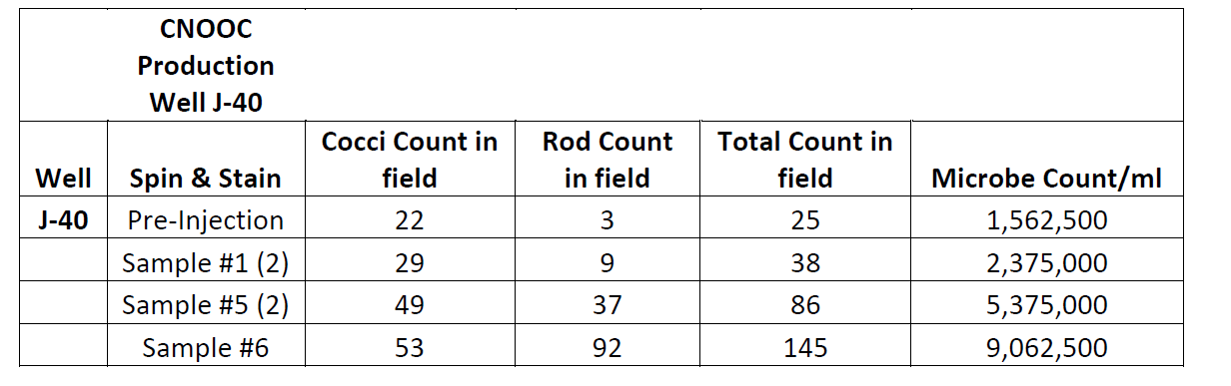
Increased Microbial Numbers
Sample #1
Sample #5
Sample #6
Rods
Cocci
Pre-Injection
Day 20
Day 36
Day 42
Plant stability and lack of test separator access has resulted in fewer J40 tests than ideal.
The microbial counts are promising, and the production behaviour is being closely monitored.

Slide 17
Lessons Learned
IMPORTANT: Stability of operating conditions
  Consistent reliable water injection
  Steady flowing pressures
  No planned shutdowns (TARs, maintenance etc)
  Routine access to test separator
Well Selection
  Choose one of your better wells for a technology trial
      It’s tempting to select a low value well, however when working with small absolute production volumes it’s often hard to differentiate a true production increment from natural fluctuation. This leads to uncertainty in trial success and premature termination of a potentially promising technology.
  A well established production trend supported by frequent well test data.
  Good understanding of production and water cut behaviour after a moderate duration shut down.
Technology deployment
  No platform engineering modifications required. Deployment is very similar to a scale squeeze or other bullheaded treatment.
  Significant cost savings can be realised by sharing pumping facilities and rig up with other routine well protection activities.
  The act of sampling and shipping the produced water samples is simple, low volume and can be performed by the platform chemist. Several samples can be shipped at once provided the earlier samples are kept warm to avoid the microbes from dying.
  After being mixed the nutrients have a used by date.

Slide 18
Conclusions
Technology deployment has been simple and cost effective, with no evidence of any damaging impact on well productivity.
There is strong evidence of increased microbe numbers within the produced water of all treated wells and affected producers
In both treated production wells (J17 and J40) the oil production increased above the pre-defined base line for a period of 1 – 3 months.
  The exact amount of the incremental oil that should be attributed to Organic oil recovery remains uncertain and subject to healthy debate within the joint venture.
  A 4% decrease in water cut at J17 supports the mobilisation of additional oil in the vicinity of the well bore.
The produced water at J40 has elevated microbe numbers due to OOR nutrient injection at J41z.
  To date there has been insufficient well testing to prove (or disprove) an incremental oil benefit.
  Due to water injection reliability a water cut decrease at J40 would be the strongest evidence of OOR effectiveness in the Scott oil field.
  A longer term flattening of the water cut trend would also be a positive indicator of the OOR technology.
The trial of OOR, including data gathering, will continue for at least another 12 months.

Slide 19
THANK YOU

