Slide 1
What’s In The Margin?
David Kemp
23 October 2019

Slide 2
Introduction
What’s in the margin?
Rising to the challenge of developing marginal reserves
Introduction to Serica Energy
Marginal Fields - a Definition
The Columbus Development
Challenges
Areas of Collaboration
Benefits to Marginal Field Owners and Others
Conclusions

Slide 3

Introduction to Serica Energy

Slide 4
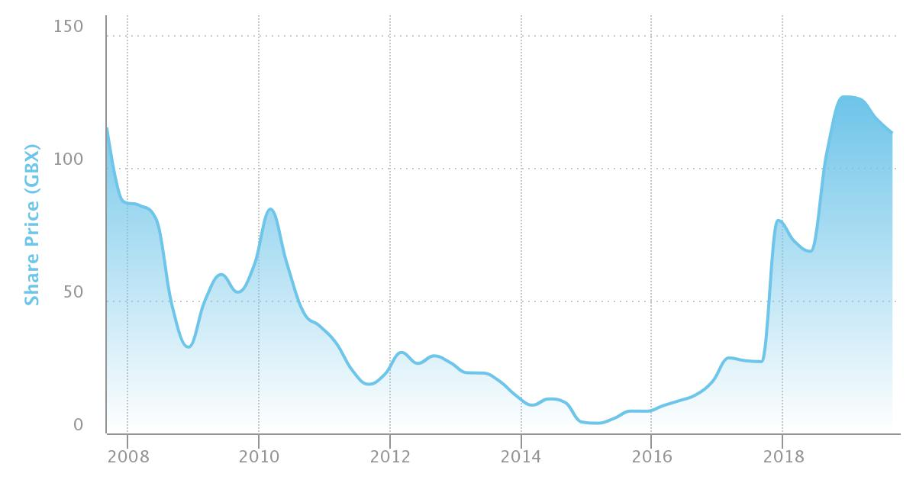
History of Serica – Share Price History
Formed in 2004
Listed on AIM in 2005
2008 developed Kambuna Field (Indonesia)
2009 discovered oil in Ireland
2010 sold Kambuna
2011 – 2014 Exploration drilling in UK and Morocco, seismic in Namibia
2015 Acquired 18% in Erskine
2016 Major cost reductions - Focus on a production deal
2018 Acquired Bruce, Keith and Rhum via a profit sharing arrangement

Slide 5
Serica’s Cash Position: Post BKR Acquisition
BKR acquisition completed on 30 November 2018
Prior to completion Serica’s cash position was £15.9 million at 30 June 2018
Post completion, it rose to £43.1million at 31 December at 2018
On 30 June 2019 its cash position was £88.2million
Under the BKR Net Cash Flow Sharing arrangements* Serica received 40% of the Net Cash Flow in 2018, rising to 50% in 2019 and 60% in 2020 & 2021
Cash, cash equivalents and term deposits £million
1H 2018
2H 2018
1H 2019
* The Net Cash Flow Sharing Arrangements cover income from the interests in Bruce, Keith and Rhum purchased from BP, Total and BHP

Slide 6
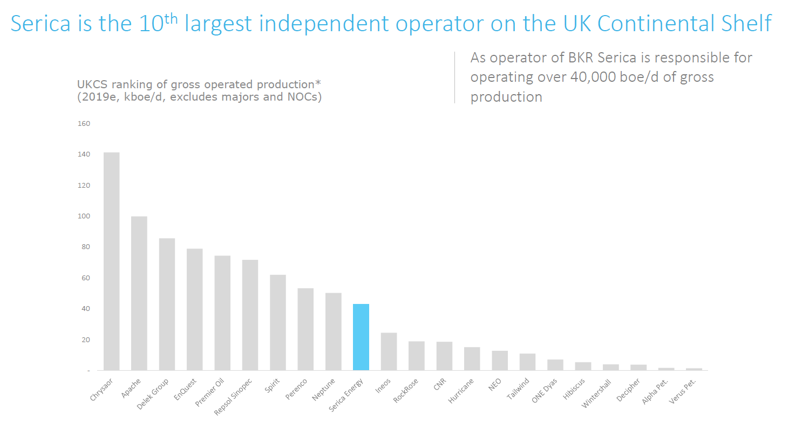

Slide 7
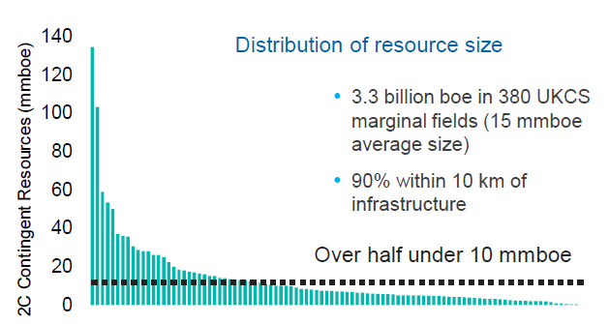
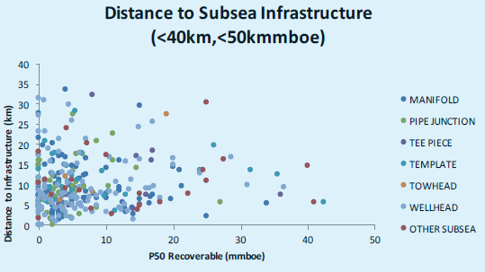
Marginal Fields – A Definition
Economic margins influenced by:
Size of pool
Cost of infrastructure
Export route availability
Cost of operation
Risk (E.G. Commodity prices)
What is marginal for one company, may not be for another – economic threshold
Source OGA

Slide 8
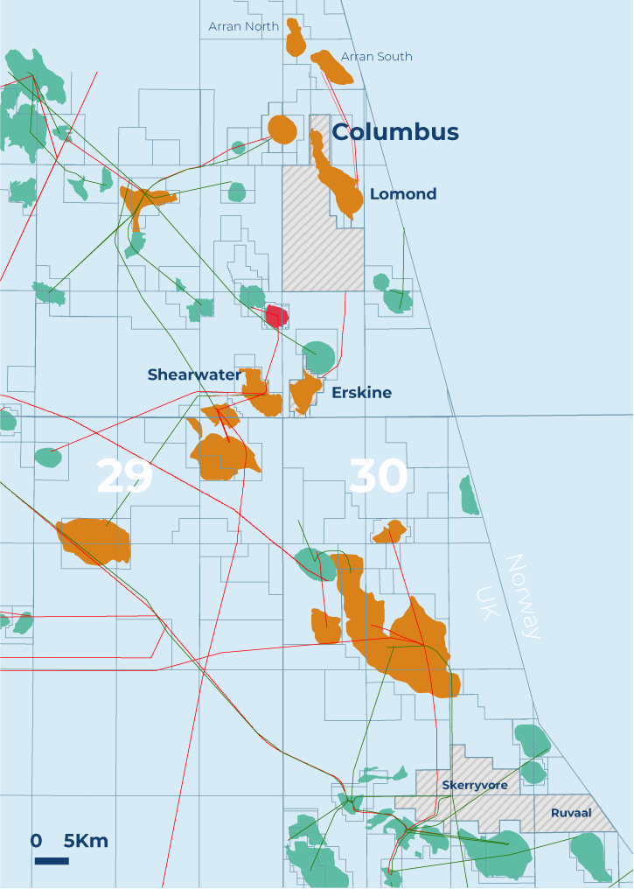
The Columbus Development
OGA have determined Columbus to be part of the Lomond field area as there is no “clear blue water” separation, so “Development”, rather than “Field”.
Separate licence terms
Separate FDP approvals
Separate export routes
No common equity holders
Gas reservoir Located in UKCS blocks 23/16f and 23/21a (Columbus Sub Area (COL)). Licences P1314, P101
Partners (Serica Energy UK Ltd. 50% (Operator), Endeavour Energy UK Ltd. 25%, Tailwind Mistral Ltd. 25%).
13.4 mmboe – (2C at FDP sanction)

Slide 9
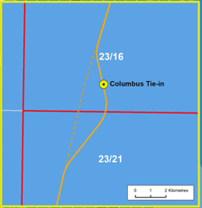
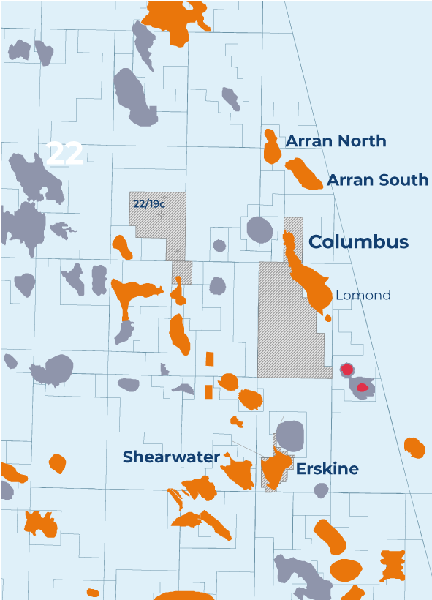
The Columbus Development
Several different development options were pursued in the past (Export via ETAP, Extended reach well from Lomond platform, Direct export to Shearwater)
Requires both commercial and technical solutions to be successful
Single well development, connected to Shell Operated Arran to Shearwater pipeline.
Timeline determined by Shell as Shearwater and Arran subsea field Operators.

Slide 10
PROJECT TIMELINE
2021
Commencement of production expected, following Arran pipeline lay and Shearwater topsides modification
Q4 2020
Target drilling of single horizontal production well tied in to Arran-Shearwater pipeline
Jun 2019
Long-lead item commitments made
Signature of rig contract imminent
Oct 2018
OGA approve Columbus Field Development Plan
Dec 2018
First major contracts placed

Slide 11
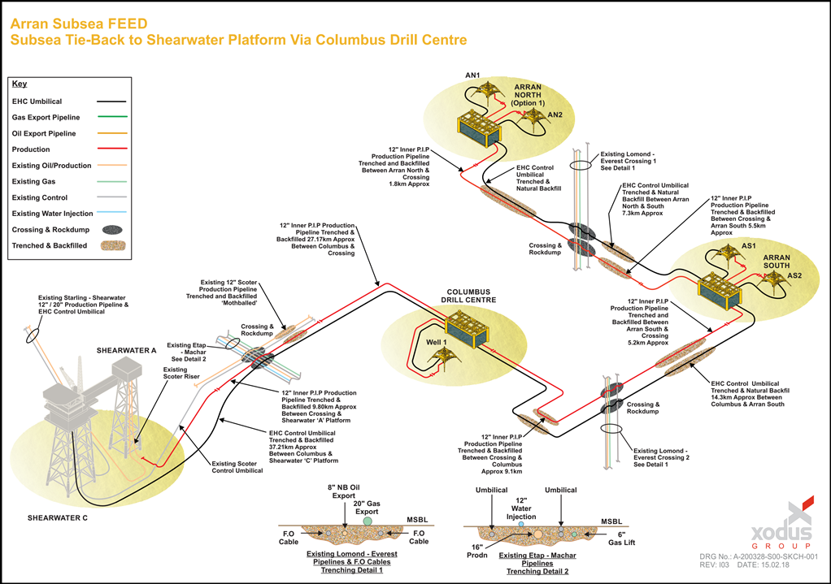
Development Strategy
Development Philosophy
Under a Construction and Tie-In Agreement, Arran:
Deviates the Arran-Shearwater pipeline to pass by Columbus wellhead location
Provides a tie-in manifold for Columbus, the Columbus Tie-in Structure (CTIS)
Incorporates Columbus specific functions in the umbilical from Shearwater to the CTIS – down-hole scale inhibitor and wax inhibitor lines
Designs, builds, installs and pre-commissions the Columbus tie-in to the well
Designs builds and supplies the control and instrumentation equipment for Columbus xmas tree
All the above to be in common with the Arran system design.
Serica is designing and drilling the Columbus well, and procuring the xmas tree system
Due to the relatively short field life, no interventions planned

Slide 12
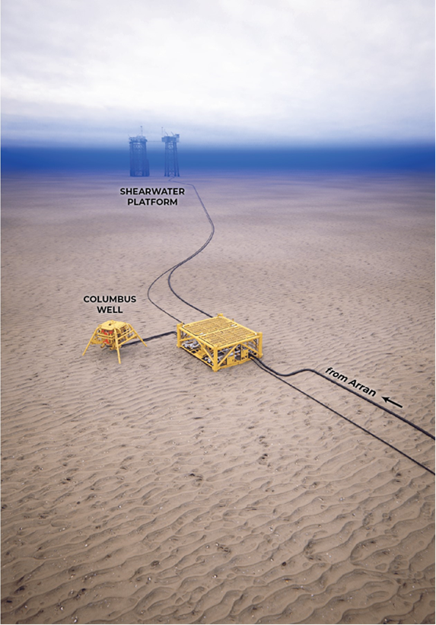
Challenges
6-10 years economic production.
Currently governed by economic cut-off due to anticipated high cost share
Reliant on Shearwater availability
If Arran reservoir fails, Columbus life will be limited because arrival temperature drops into hydrate region.
Columbus will not do cold start alone – risk of hydrates in the Arran leg of the pipeline
Columbus will only start up into a warm, pressurised, producing pipeline
General observations
Drivers of the assets may be different - requires alignment
Timeline – host infrastructure
Complicates development
Scale – competition for resource and budget
Impact on host facilities
Compensation mechanisms

Slide 13
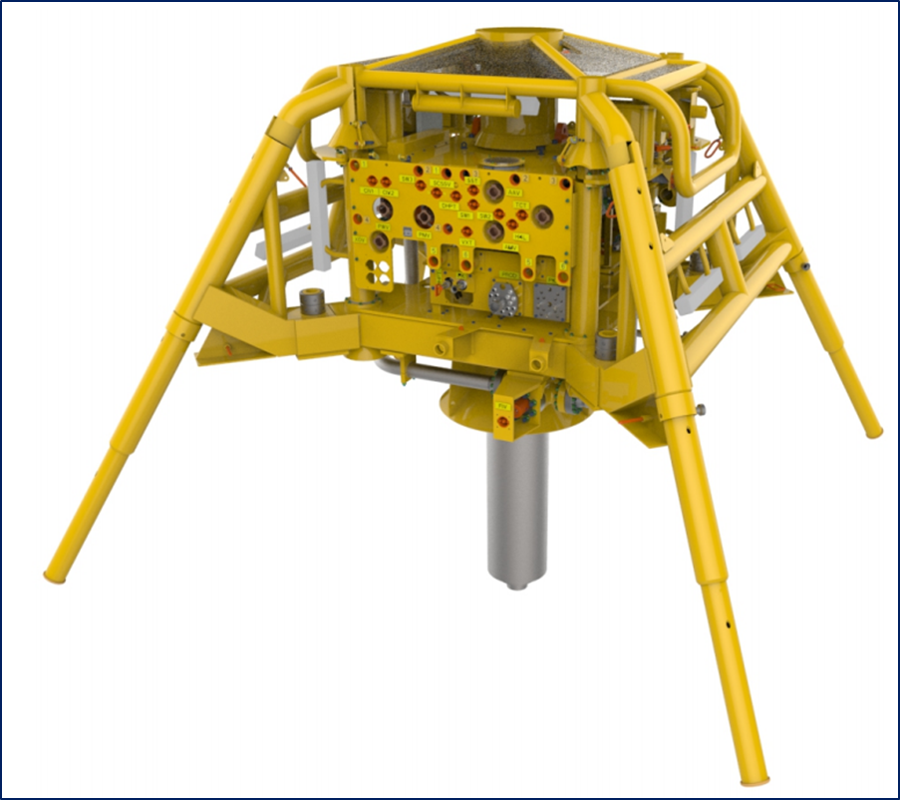
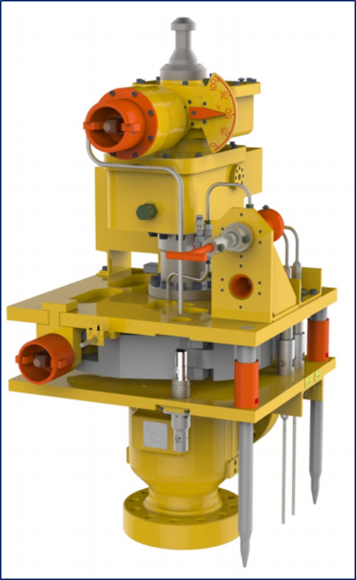
Areas of Collaboration
Collaboration is key to success
Infrastructure – avoidance of large CAPEX
Opex Versus Capex
Data sharing – Well Design, Sub sea
Drilling – Rig share
Peer review and lessons learned
Spares – SCM, harnesses etc

Slide 14

Marginal fields - why bother?
Tariff income for host facilities
Extension of Hosts’ productive life
Technical -Extends Arran production (flow assurance)
Commercial – cost share/ tariff
Host Infrastructure COP delay (big financial benefit!)
Maximising Economic Recovery – Government policy

Slide 15
In Conclusion
Marginal fields need a different approach
Consider future infrastructure as well as existing (tie-ins extend life)
Pursue production clusters or collaborations
Marginal - can create technical and commercial tensions
Need a technical and commercially viable solution to succeed
Rely on an approach of mutual gain – win-win
Benefits to host facility as well as field
Collaboration is key to success !

